Slide 1
Securing Australia’s
Future Energy: safe
Microbes to molecules: unlocking our energy resources
^{CRICOS Provider code 00301J}
Curtin University is a trademark of Curtin University of Technology.
Notes:
Good evening ladies and gentleman – thankyou for attending this evening please can we take a few minutes of your time to introduce to SAFE

Slide 2





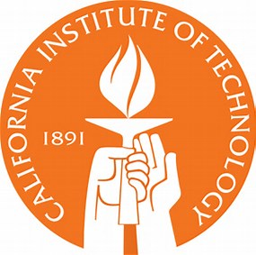


International Research Centre
Highly Innovative, Collaborative
Workshop (February 2017 with Government, Industry & Universities).
Engagement (Industry provided 10 research questions).
Transitional era for energy source in a carbon constrained world.
Do we have adequate, quality resources?
The Centre will answer fundamental questions on the formation, quality & distribution of resources to secure & assure our future demand.
Notes:
Apologies from Andrew Heap Geoscience Australia- we do have some key researchers from GA. We consulted industry about the most significant questions that need addressing. We held a workshop earlier this year following from a national and international consortium established from previous discussions. We have formed a highly collaboative, industry, government and universities. From industry we obtained 10 significant questions. This Sundowner is to engage further with potential partners and seek your valuable feedback.

Slide 3













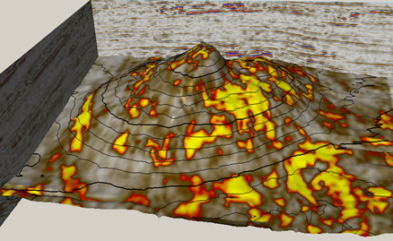
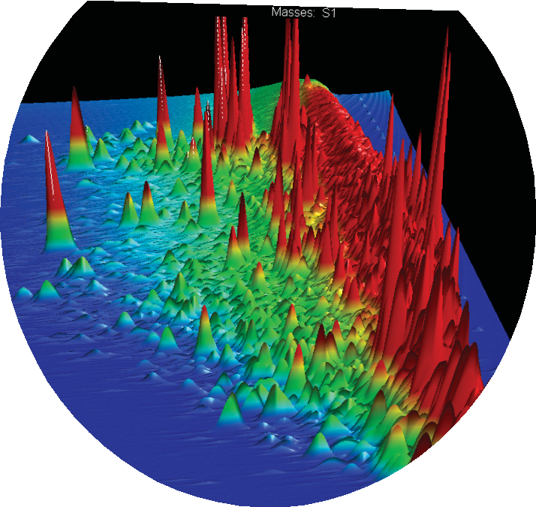

Three Research Strands
CO
2
2. Molecules & Microbes to Stored Energy
1. Crustal Architecture
& Fluid History
CH
4
3. Organic Stratigraphy
& Energy Security
Seismic to Geochemical & Depositional Facies
Notes:
These are the 3 main research science strands that industry requested for the Centre.
1
2
3
A few of the strand leaders will talk about some examples of science to be achieved.
The first of these strands is to see how we can relate the organic geochemical and depositional datasets to the basin-wide seismic datasets in the NWS, and develop linked SR facies models, that can be used and refined as analogues for other Australian and overseas basins. First over to Greg Smith

Slide 4
1. Crustal Architecture & fluid history
How can we relate geochemical & depositional parameters
to seismic signatures at field & basin scales?
Can we integrate new technology to trace & date
the poly-phase history of fluid evolution & transport?
What is happening to organic matter/fluids
during maturation & migration, &
how do we measure & fingerprint this process?
Notes:
Cut to Next Slide – Greg to Expand

Slide 5
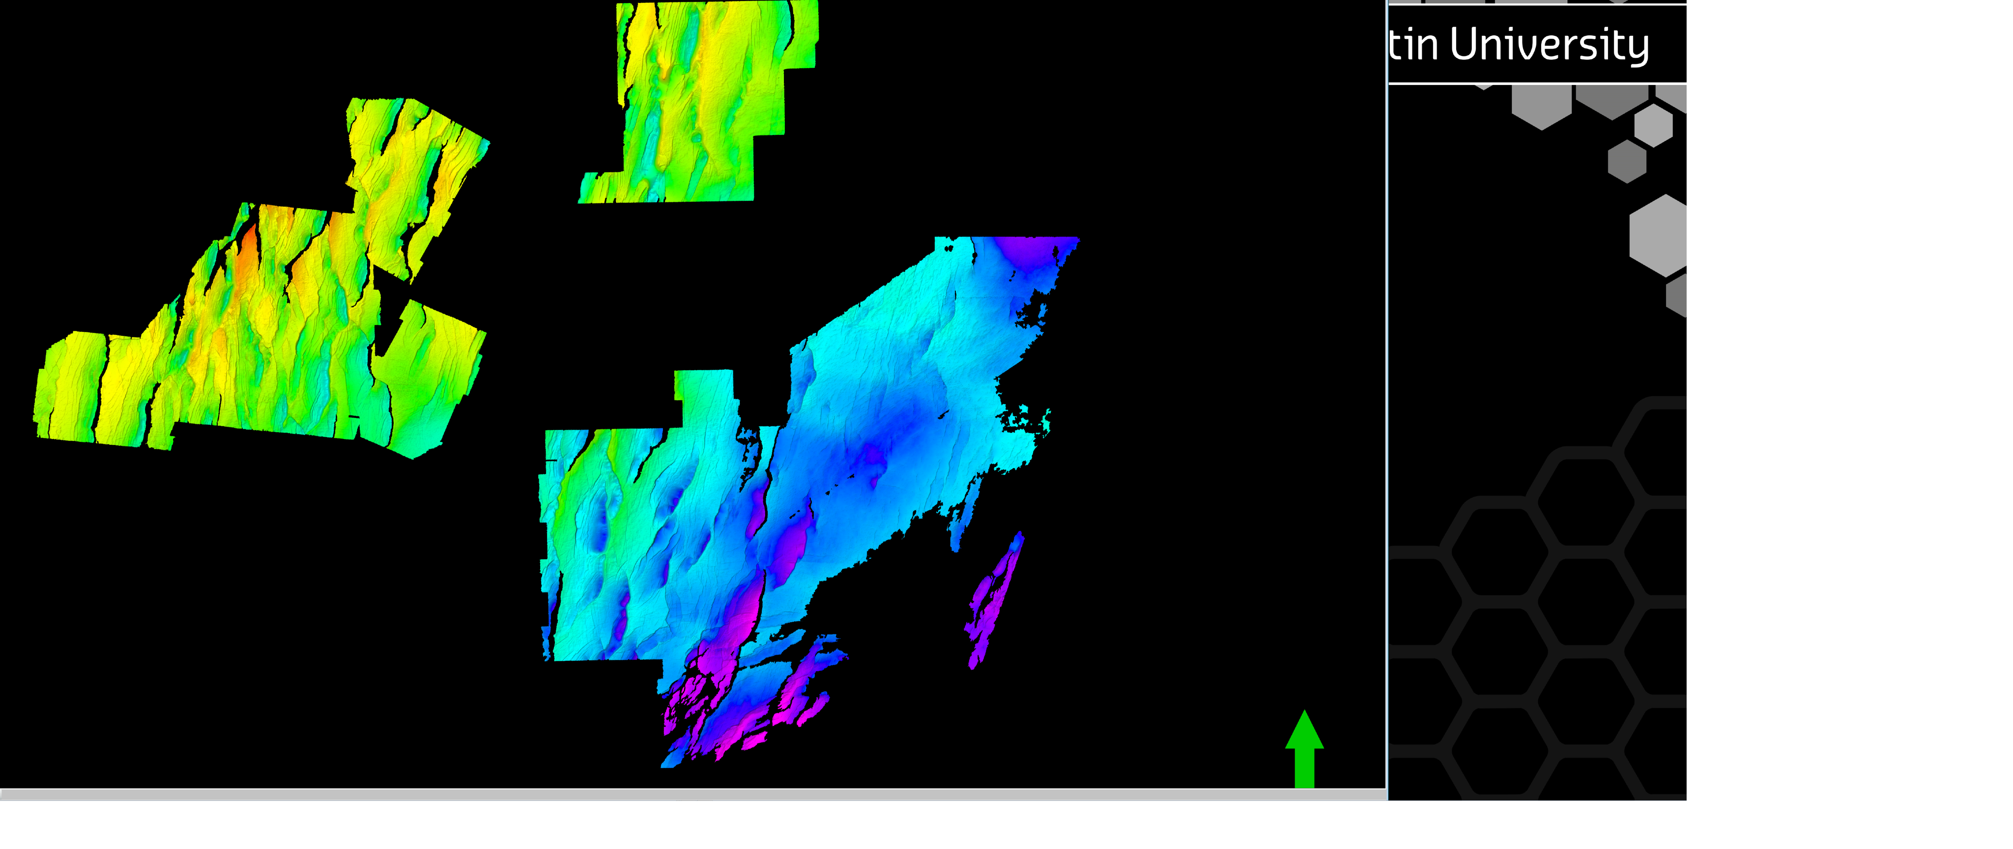
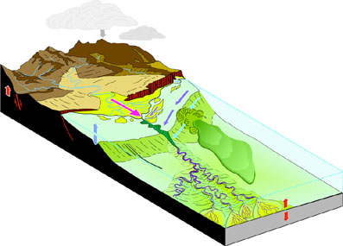
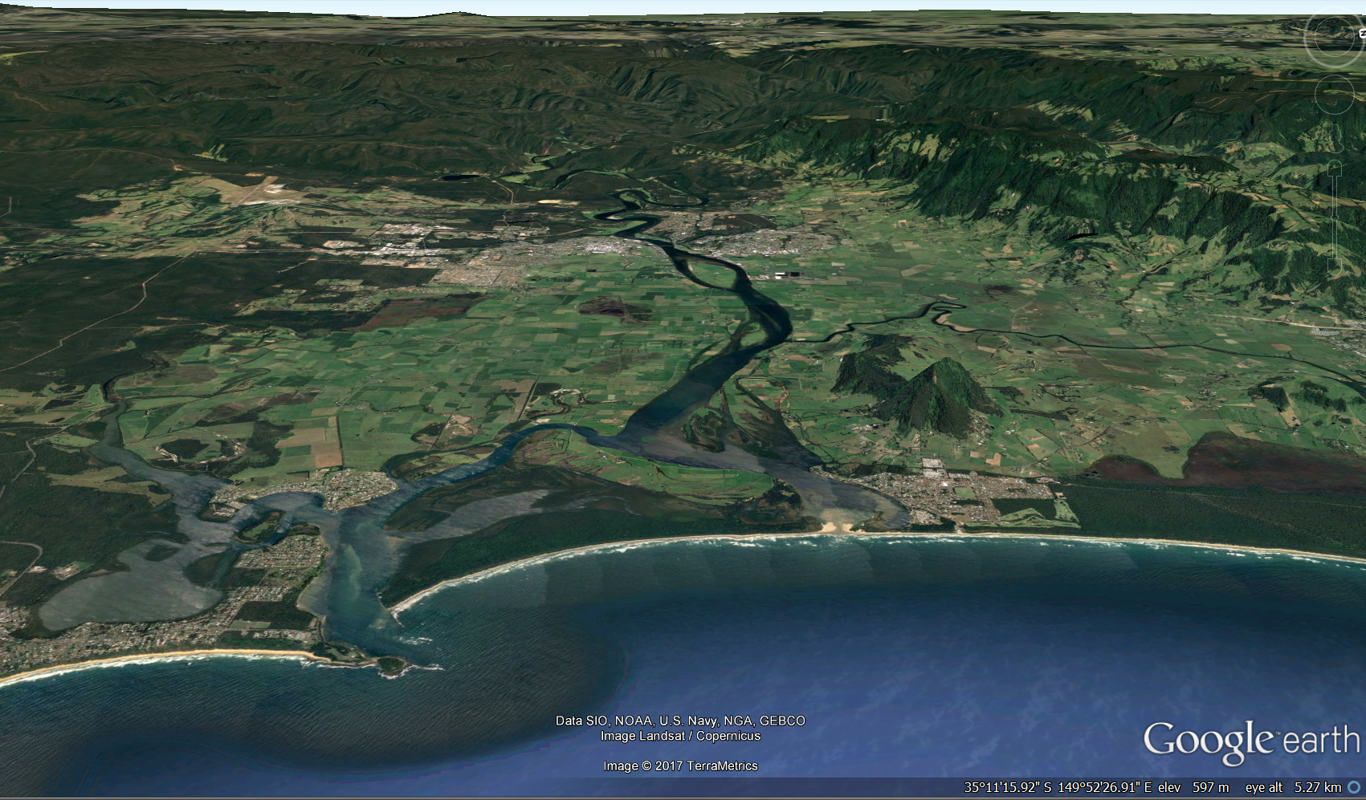
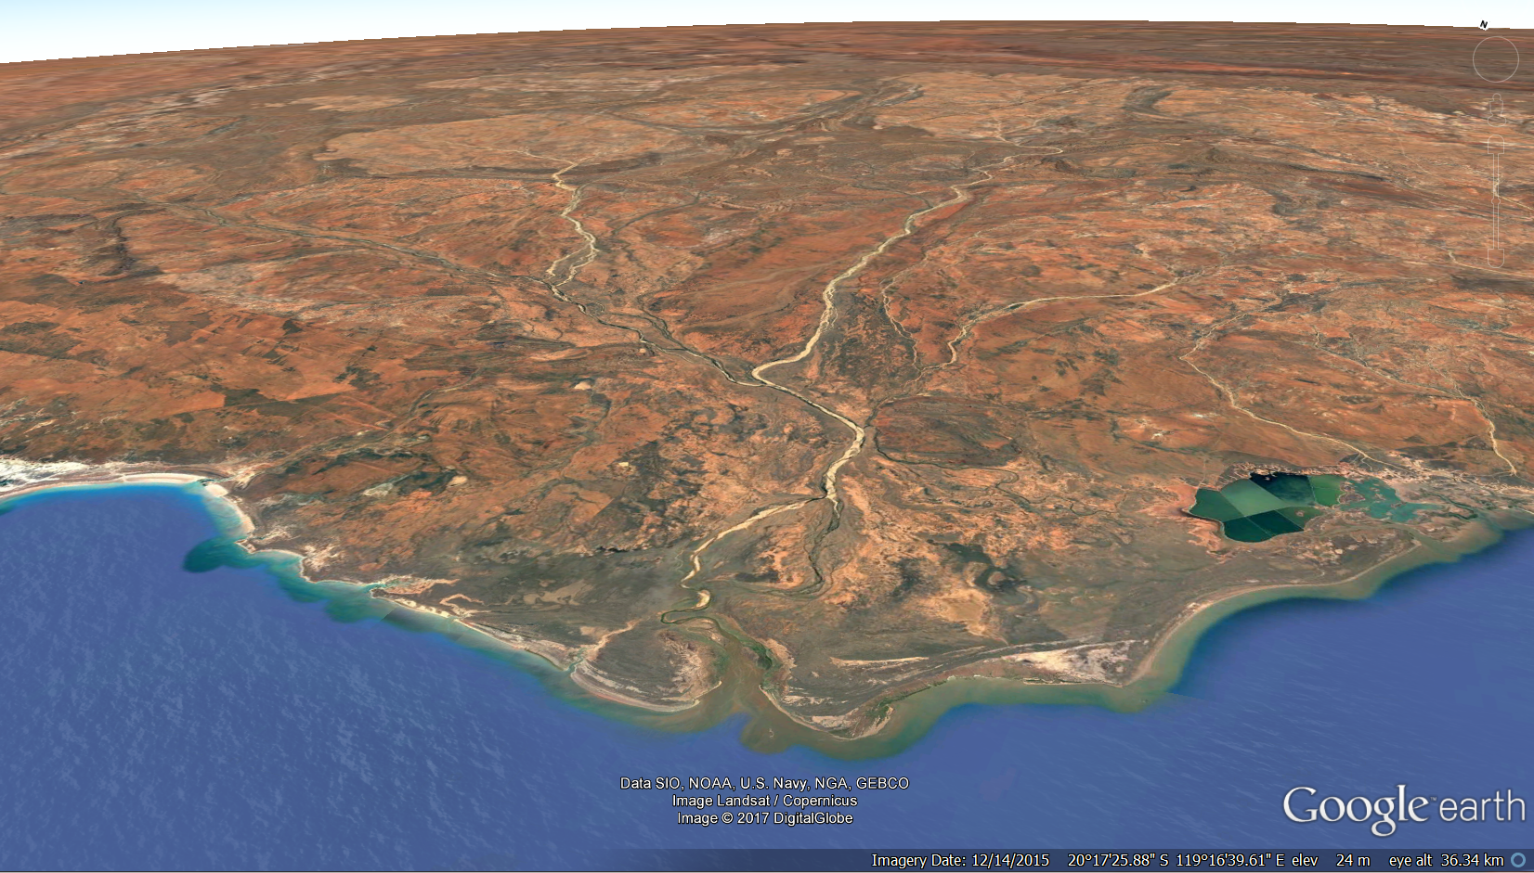
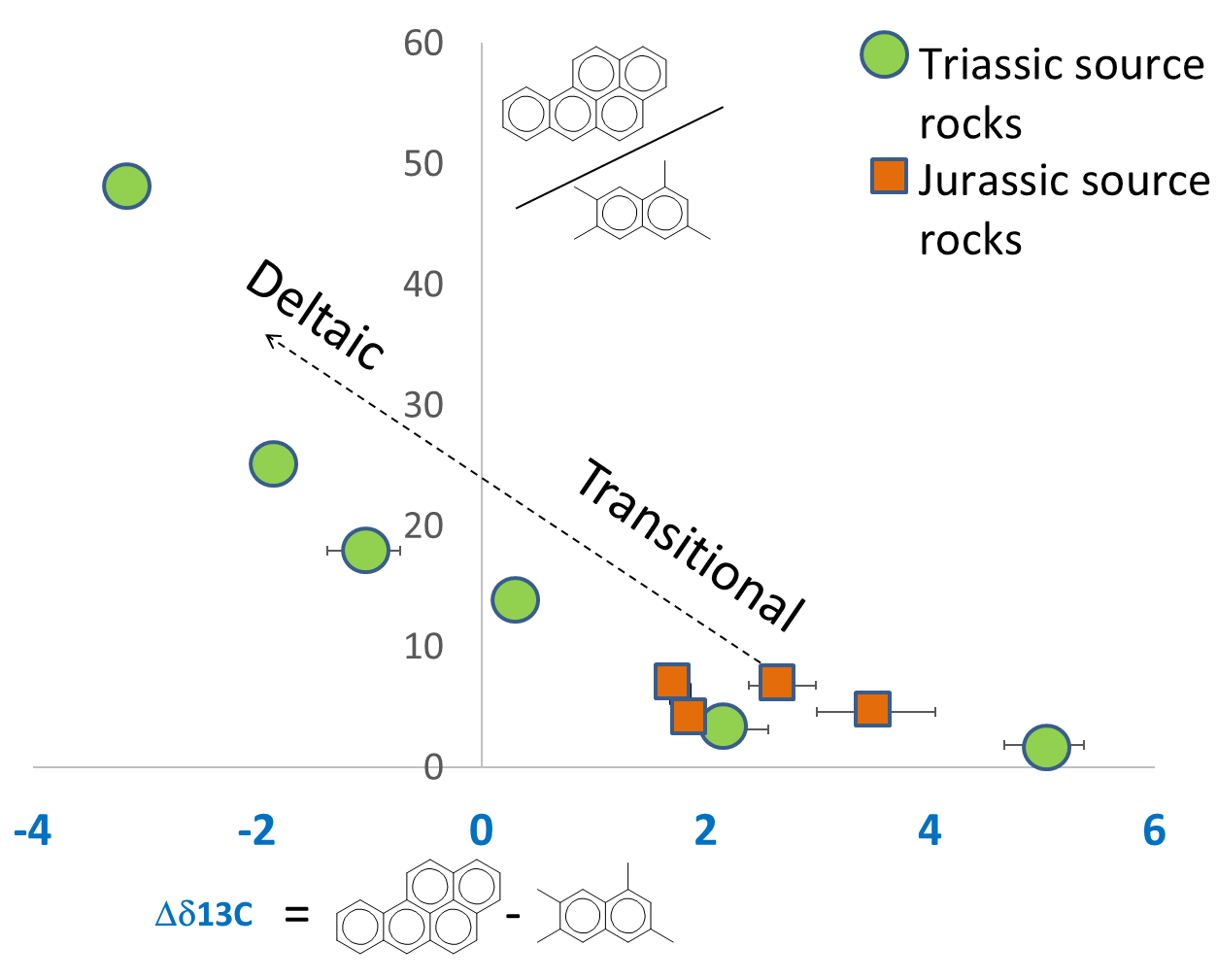
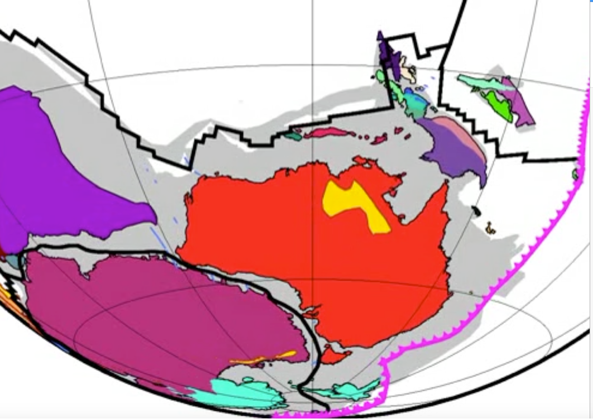
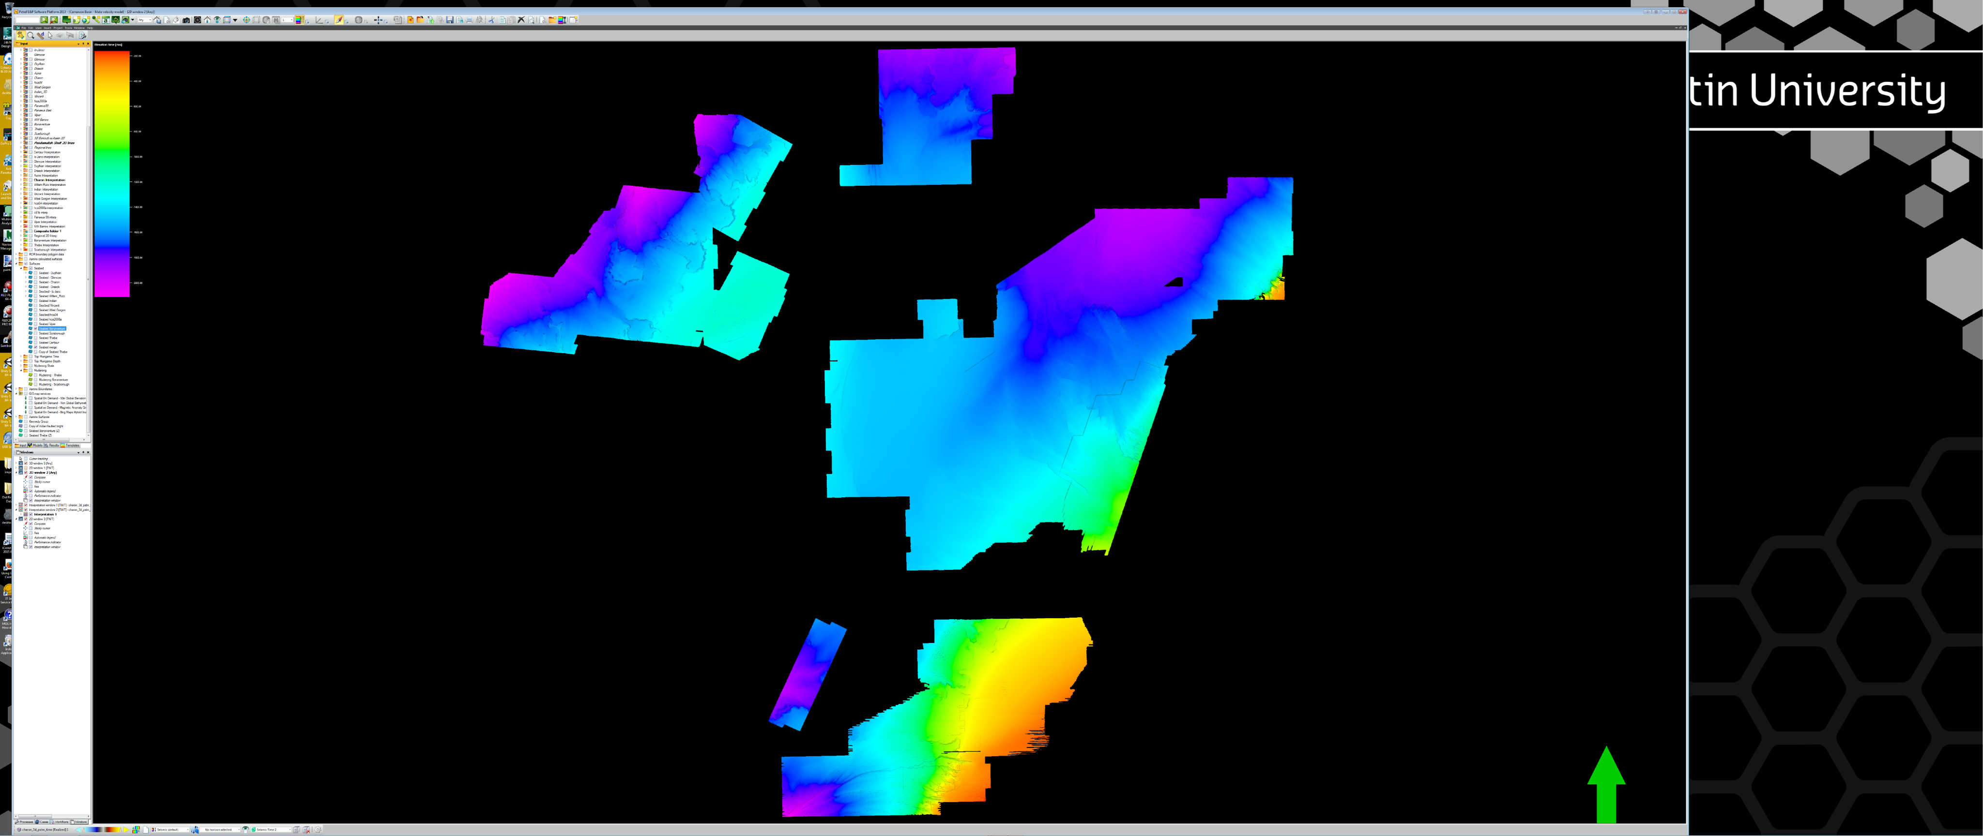
  Relate Depositional & Organic Facies to Seismic Signatures
Marine Source Rock Facies
Fluvial Source Rock Facies
DeGrey River, NWS
Fluvial Source Rock Facies
Shoalhaven River, NSW
Deltaic Source Rock Facies
Barrow sub-basin
bounding fault
Tectonic reconstruction from Gibbons et al. (2015)
  Initial Focus on Australia
  Huge NWS Datasets
  High Quality Open File
  Seismic & Attribute Analysis
  Relate Source Rock OM to oils
  Partner with Industry Participants
Subcrop of Top Mungaroo
beneath MJU
2000
N
Depth (m)
50 Km
5000
Notes:
We would like to partner with some of the Industry Participants in the processing, imaging, interpretation and synthesis with the Big Data Files

Slide 6
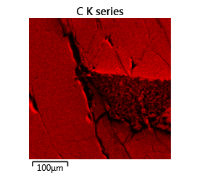
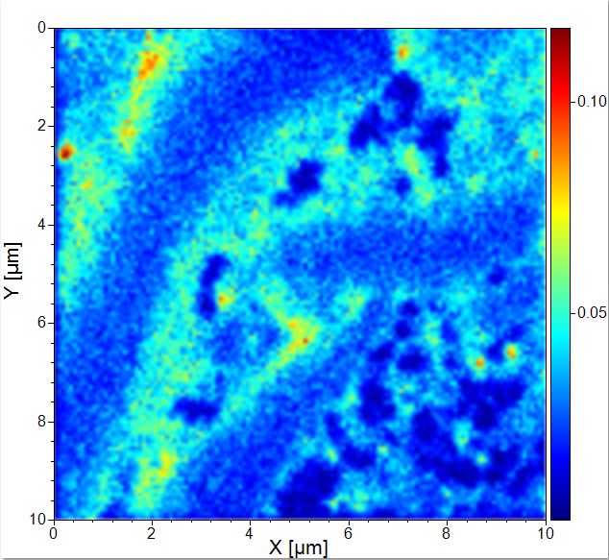
Integrate New Technology,
Track Organic Matter Maturation & Fingerprint
Example: In-Situ Nano-Scale Analysis of Organic Matter:
Automated Elements, Isotopes & Molecules
TOF-SIMS Map of Carbon in Massive Vitrinite from Tertiary New Zealand sample
TOF-SIMS Map of Carbon in Vitrinite varying from Cell wall layers (high orange) to cell contents (low blue)
Notes:
Curtin’s John de Laeter Centre has some of the world’s leading instrumentation, including SEMs that can measure geochronology, palaethermomentry and composition in source rocks and reservoirs at the nano and even molecular scale and Kliti will discuss similar MS instruments that can also characterise liquids and gases.
Here is some of the world’s first pictures of in-situ nano-scale analysis of organic matter in organic rich rocks using Curtin’s latest TOF-SIMS SEM. This will potentially revolutionise how we analyse organic matter maturation and source rock type even for minute dispersed organic matter and hydrocarbons in unconventional plays.

Slide 7
2. Molecules & Microbes to Stored Energy
How does inorganic material interact with organic matter during transformations?
Organics to oil - What is the role of microbes in the transformation of organic matter into hydrocarbons?
Reducing risks with microbial fingerprints - Can we identify controls & characterise source rocks using biomarkers & microbial signatures?
Penalties to production: Microbial interactions & future energy generation - Can our understanding of microbes & their processes be used to create new energy sources or maximise recovery & optimise processing?

Slide 8
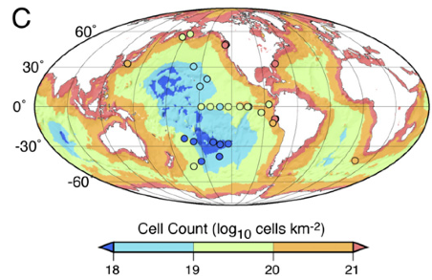
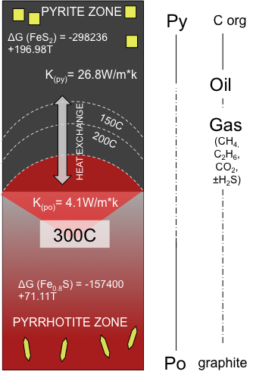
Marine subsurface microbial biomass
Kallmeyer et al., 2012 PNAS
CO₂ CH₄
Nutrients
e-acceptors
salinity
pCO2
Water
Porosity
Orsi et al., in review
Notes:
Globe image: Marine sediment contains >10²⁹ microbial cells, about 10% of the total biomass of the planet, which is concentrated at continental margins. The majority of these microbes are found at greater depths, below the sulfate reduction zone. In the absence of traditional electron acceptors, bacteria are involved in transforming complex biomolecules into kerogen. Their role in the transformation of kerogen to oil and gas is poorly understood. This CoE aims to use advanced molecular biological tools as well as lab-controlled incubation experiments to provide a holistic overview of the microbial diversity and processes involved In the transformation of OM into kerogens and ultimately hydrocarbons.
NMDS plot: The deepest marine deep biosphere was recently discovered at 2500 m below the surface, but the limits of life are probably at least 1000 m deeper than that. In that study bacterial cell counts were elevated in a coal bed at 2 km deep and the microbial communities resembled those typically found in forest soils rather than the marine realm. This suggests that the deep subsurface microbome can reveal insights about the paleodepositional environment. We recently performed a high sampling resolution study on a Pleistocene sediment record from the Indian Ocean and found that the subsurface microbiome was significantly different before and after the LGM and the separation was caused by different plankton sources of sedimentary OM during the glacial (predominated by green algae) vs. a predominance of diatoms and dinoflagellates during the interglacial. It is to be expected that the microbial genetic fingerprints in oil samples from different depth and age might be significantly different. In that case, this novel approach could assist lipid biomarker profiling to characterise oils.
Co2 to CH4 transformation: We will also be looking for ways to activate or enhance microbes in reservoirs to convert CO2 into methane. If CO2 is building up in a reservoir and is not converted to CH4 it means that something is inhibiting microbial activities involved in these processes. This could be a lack of nutrients or electron acceptors or a too high salinity to support microbial life. Perhaps it is a matter of increasing porosity. We can bring samples from such reservoirs to the lab and under controlled incubation experiments find out how CO2 to methane production can subsequently be initiated or enhanced in the field and to make this economically feasible.
Mineral transformations during catagenesis can release trace elements and form new minerals. These trace elements could be important to support microbial life in deep subsurface hydrocarbon reservoirs. Mineral adsorption also promotes preservation of organic molecules and the likelihood of their transformation into oils.
The mineralogy and chemistry of prospective rocks can help understand their thermal history, as wells, predict and track how these rocks will behave during oil formation. Studying these processes in more detail is another aim of this particular strand.

Slide 9
3. Organic Stratigraphy & Energy Security
Can we predict new global source rock intervals
without drilling source-rocks?
What methods can we develop to quantify volume & phase
of generated hydrocarbons?
Can we determine the depositional architecture of source rocks?
The aim of this strand is to de-risk presence & effectiveness of source rocks from frontier to mature basins

Slide 10
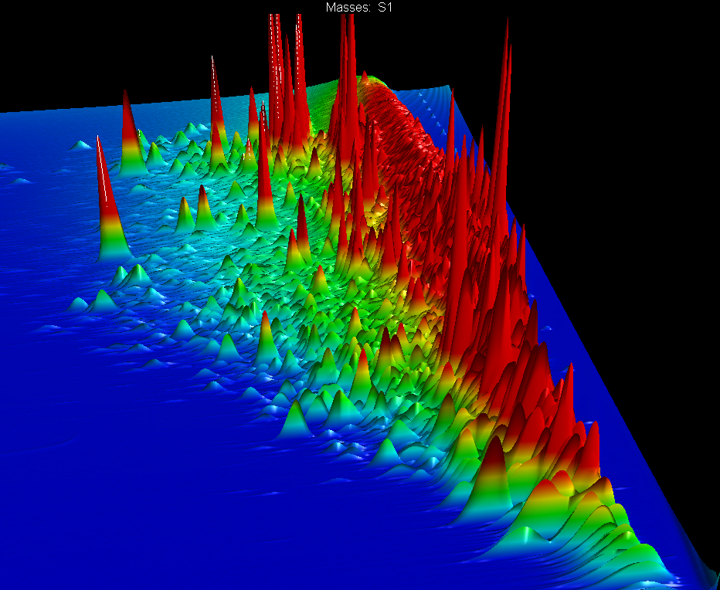
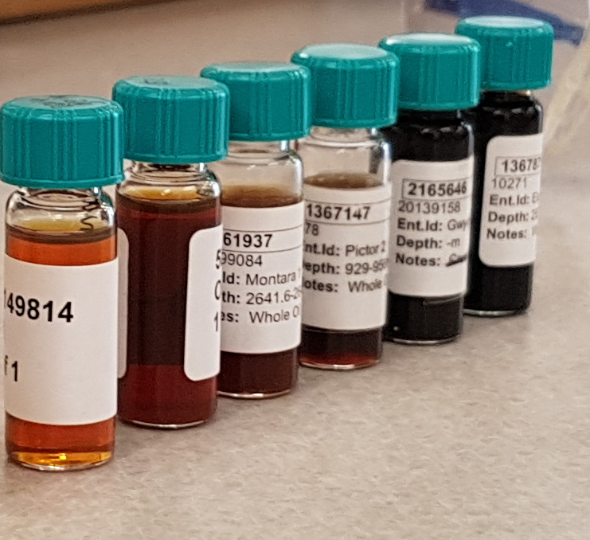

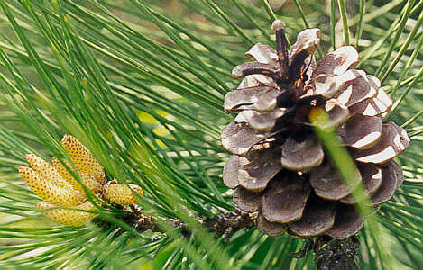
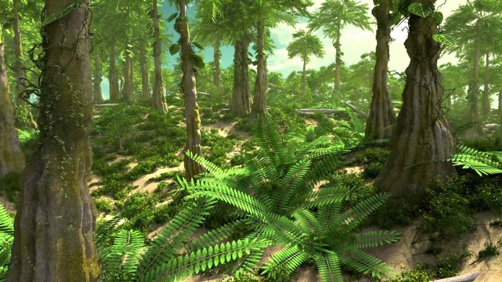
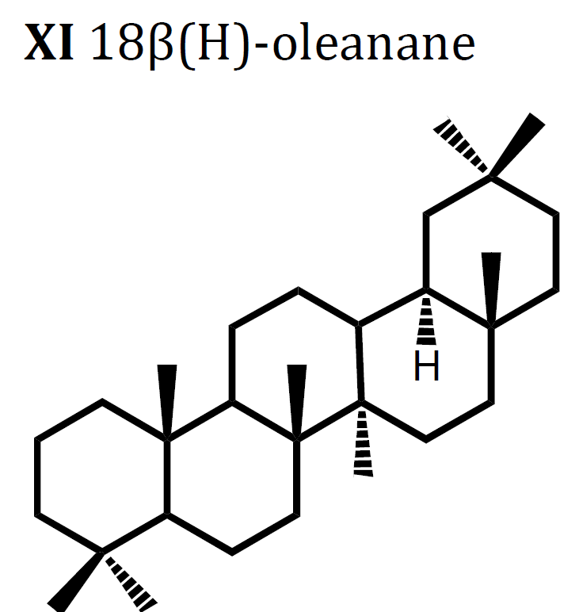
Can we predict new global source rock intervals without drilling source-rocks?
angiosperms
gymnosperms
first trees
0
50
100
150
200
250
300
350
400
GEOLOGICAL TIME (MILLION YEARS)
Notes:
Or change angiosperm to flowering plant
Gymnosperm to non-flowering plant or seed producing plant
We can track specific molecules from different organisms. We have established a molecular and isotopic tool based on the abundance of suits of compounds analysed in 3 dimensions to increase the age resolution of SRS for the entire Tetiary and have age resolutions on oils by 5 miliion years. There’s no need to drill a source rock to establish the source rock age of such samples. We have established this tool from well biostratigrphically dated source rocks. Applied an age parameter to oils. We can do such age analyses for many other organic molecules that are derived from specific age diagnostic molecules.

Slide 11
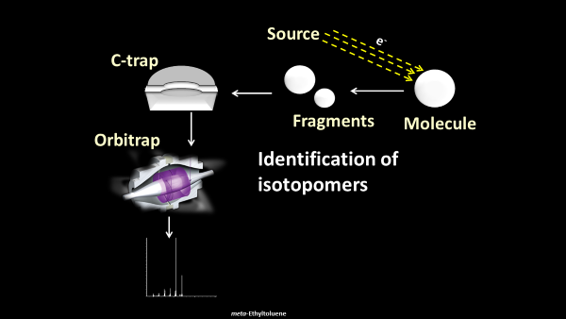
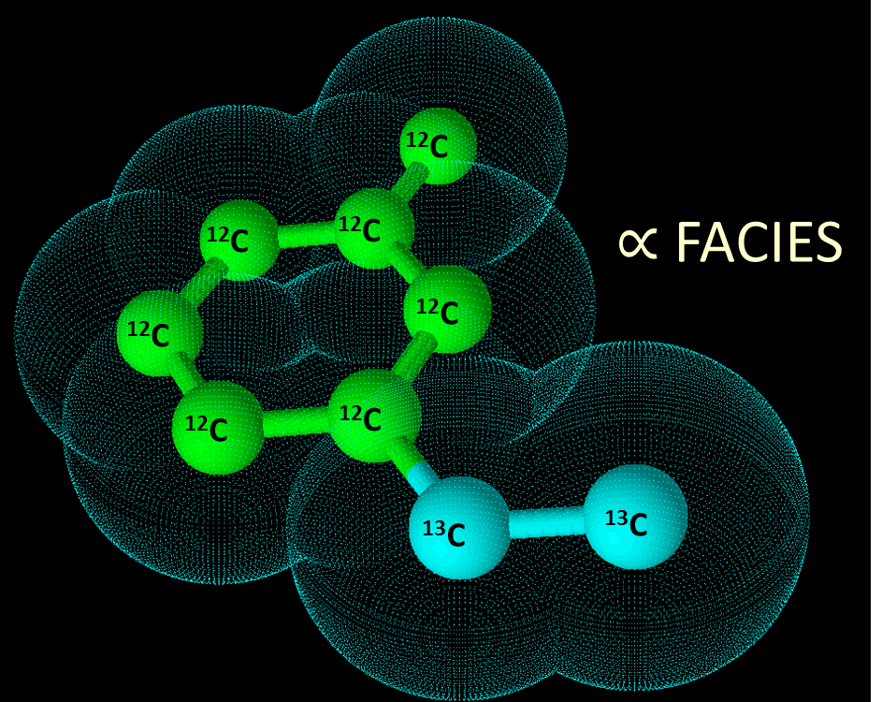
Site-specific isotope distribution in alkyltoluenes
Notes:
The orbitrap technology enables the identification and semi-quantification of isotopomers from organic molecules from petroleum (gases and we have done the first liquid analysis ever). Alkyltoluenes and similar compound classes were found to have site-specific isotope distribution due to interactions with minerals during primary migration. Site-specific isotope analysis of Australian petroleum fluids will significantly improve our understanding of the distribution and abundance of light hydrocarbons resources in the region.

Slide 12
Securing Australia’s
Future Energy: safe
Thank you
^{CRICOS Provider code 00301J}
Curtin University is a trademark of Curtin University of Technology.

